Slide 1
Road Tunnels Air Quality Considerations Community Meeting - Balgowlah Golf Club
Noel Child (NG Child & Associates)
Thursday November 22nd 2018

Slide 2
Existing Sydney Road Tunnels

Slide 3
New Developments

Slide 4
Existing Sydney Road Tunnels
TUNNEL | LENGTH | VENTILATION | STACKS | AIR TREATMENT
Harbour | 2.3 km | Transverse | 1 | None
Eastern Distributor | 1.7 km | Longitudinal | 1 | None
M5 East | 4.0 km | Longitudinal | 1 | None (Note 1)
Lane Cove | 3.6 km | Longitudinal | 2 | None (Note 2)
Cross City | 2.1 km | Longitudinal | 1 | None (Note 3)
Note 1: ESP & DeNOX system trialled Note 2: Capacity for air treatment included in design Note 3: Capacity for air treatment included in design

Slide 5
New Tunnels … getting longer & busier
North Connex Details (a typical example)
Length: 9.2 km
Lanes: 3 in each direction (two initially)
Ventilation: Longitudinal
Air Treatment: None proposed
Emission Stacks: One at each end

Slide 6
Some Air Quality Issues
In Tunnel
External
Pollutants of Concern
Carbon Monoxide
Nitrogen Dioxide
Hydrocarbon Residues
Fine Particulates (PM10 & PM2.5)

Slide 7
Ventilation & Air Quality Options
Ventilation
Longitudinal
Transverse
Air Cleaning
Particulates
Hydrocarbon Residues
Nitrogen Dioxide

Slide 8
Ventilation Options
Longitudinal
Transverse

Slide 9
Air Treatment Options
Fine Particulates
Electrostatic Precipitation
NOX & Hydrocarbons
Catalytic Processes

Slide 10
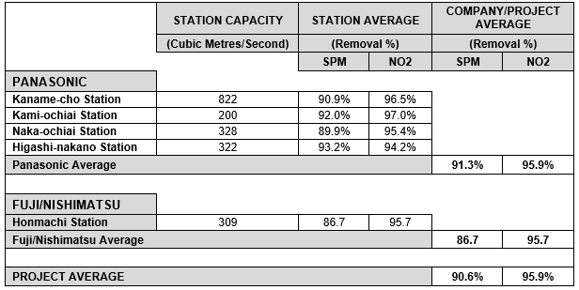
Air Cleaning Efficiencies
Tokyo Tunnel Example

Slide 11
Air Treatment Volumes
 | TOKYO SHINJUKU LINE | MADRID CALLE 30 | M5 EAST TEST PLANT
Total ESP Volume (M³/Sec) | 3509 | 5404 | 200
TOTAL DeNO₂ Volume (M³/SEC) | 3509 | 2114 | 50
Total Treatment Volume (M³/Sec) | 7018 | 5404 | 200

Slide 12
New Tunnels … getting longer & busier
North Connex Details (a typical example)
Length: 9.2 km
Lanes: 3 in each direction (two initially)
Ventilation: Longitudinal
Air Treatment: None proposed
Emission Stacks: One at each end

Slide 13
International Experience
TECHNOLOGY: Air treatment proven & established for appropriate applications Ventilation method selected on a performance basis
SPAIN: Extensive evaluation of “long tunnel” ventilation and air treatment technologies in Madrid – various ventilation methods and air treatment technologies adopted
JAPAN: Recent Tokyo metropolitan road tunnel a good case study – Yamate Tunnel 18 kilometres in total comprising separate 8 km and 10 km tunnel sections – transverse ventilation and air treatment incorporated
STOCKHOLM: Proposed E4 By-Pass Tunnel – longitudinal ventilation but complete air exchange every three kilometres

Slide 14
NSW Approach
VENTILATION: All tunnels longitudinally ventilated
AIR TREATMENT: Air treatment technology “not RMS policy”

Slide 15
Key Considerations
POLICY
A Balanced & Integrated Approach
Roads + Rail – NOT Road Only
Treat the public as a genuine stakeholder
Good Process Essential
AIR QUALITY
Air Quality Must be Safeguarded
Stacks and “Filtration”
Stack Locations
Air Quality Monitoring – In-Tunnel and External
VENTILATION
Appropriate Tunnel Ventilation
Proposed Ventilation Method a Potential Concern
Ventilation & Air Quality Linked
Minimum Cost/Maximum Profit Approach Risky

Slide 16
The Issues
ALTERNATIVES NOT CONSIDERED
TUNNEL VENTILATION
EXHAUST EMISSIONS
HEALTH IMPACTS
CONCERNS FROM KEY GOVERNMENT AGENCIES
CONCERNS FROM THE MEDICAL PROFESSION
CONCERNS FROM REGULATORS
CONTEMPT FOR THE PUBLIC

Slide 17
The Solutions
GOOD PROCESS
CONSIDER THE OPTIONS
APPROPRIATE TUNNEL VENTILATION
EXHAUST AIR TREATMENT IF NEEDED
INDEPENDENT AIR QUALITY MONITORING
INDEPENDENT OVERSIGHT
TRANSPORT POLICY PRIORITIES
RESPECT FOR THE PUBLIC

